Slide 1
UK & Ireland Programming Contest 2026
UKIEPC 2026 Problem Solutions
Presented by the UKIEPC 2026 Jury
Contest Walkthrough & Reference Guide

Slide 2
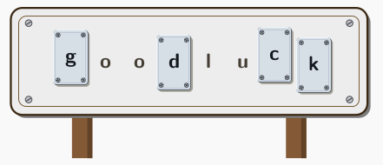
Problem A: Austere Sign
Adjust the letters on a sign to use at most k distinct letter stencils.
Minimize the total number of edits.
•
Count the frequency of each distinct character across all words in linear time O(N).
•
Sort character counts and preserve the k most frequent letters to minimize replacements.
•
Replace all discarded characters with the most common preserved letter.
Time Complexity: O(N + Σ log Σ) = O(N)

Slide 3
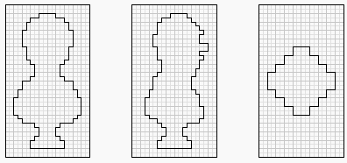
Problem B: Bust Blasting
Find the volume of a 3D solid carved by intersecting three axis-aligned projections: front (xy), side (zy), and top (xz).
•
Compress coordinates: collect unique X, Y, and Z values to discretize space into at most 200 intervals per axis.
•
Rasterize each 2D projection onto a 200 × 200 bitmap using the standard even-odd fill rule.
•
Iterate over all 200³ = 8,000,000 elementary cuboids; add Δx · Δy · Δz whenever a cell is active in all three views.
Time Complexity: O(N³) - but can be optimised to O(N²)

Slide 4
Problem C: Cryptlet
Solve the cryptarithm X + Y = Z where operands have up to 1,000 digits but use only 5 distinct letters (a through e).
•
Assigning 5 distinct digits from 0–9 yields only 10! / 5! = 30,240 candidate permutations to test.
•
Precompute base-10 positional weight sums for each letter modulo large primes in linear time O(|X|).
•
Check linear combinations in O(1) time per permutation; verify candidates with 2 additional primes.
Time Complexity: O(|X| + K^{K})

Slide 5
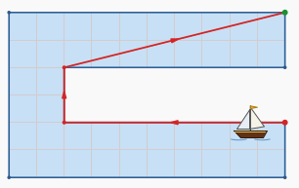
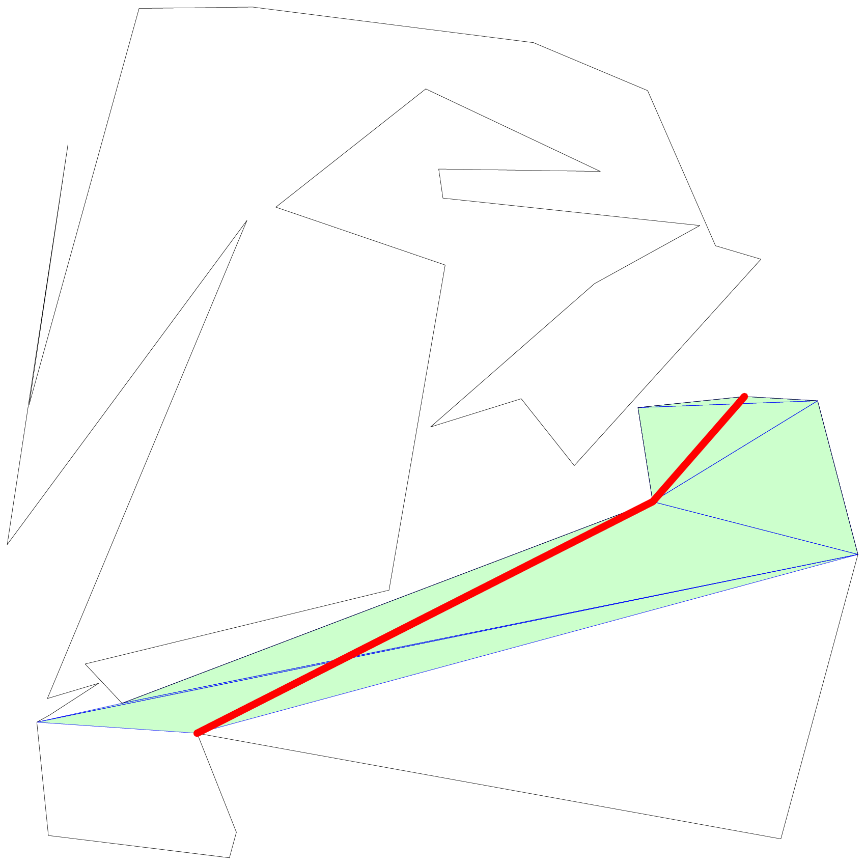
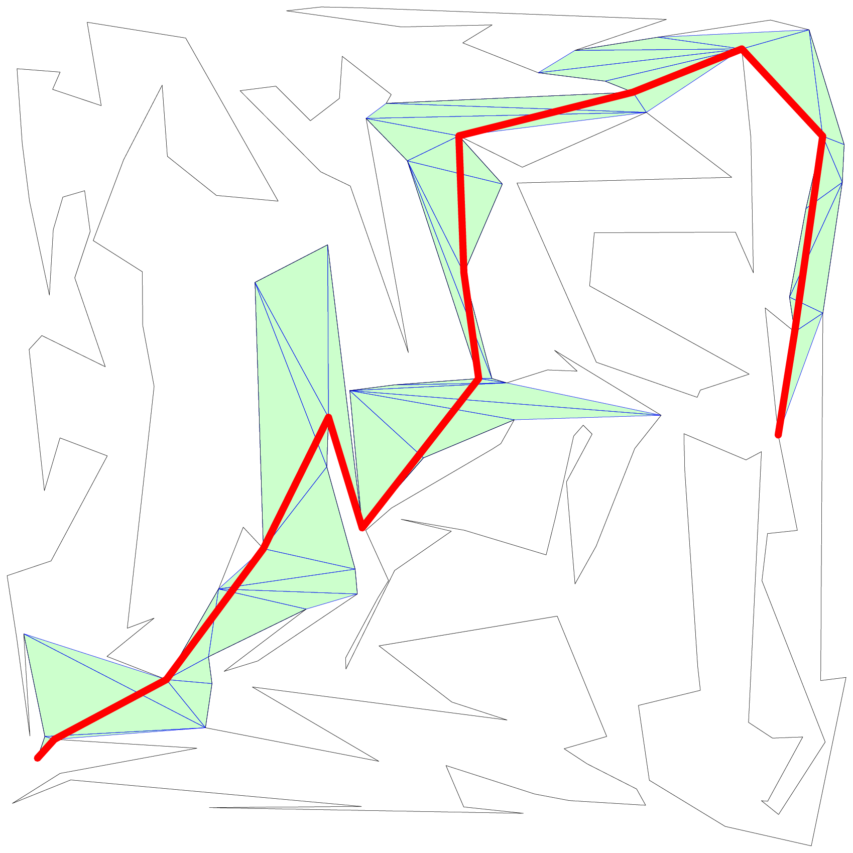
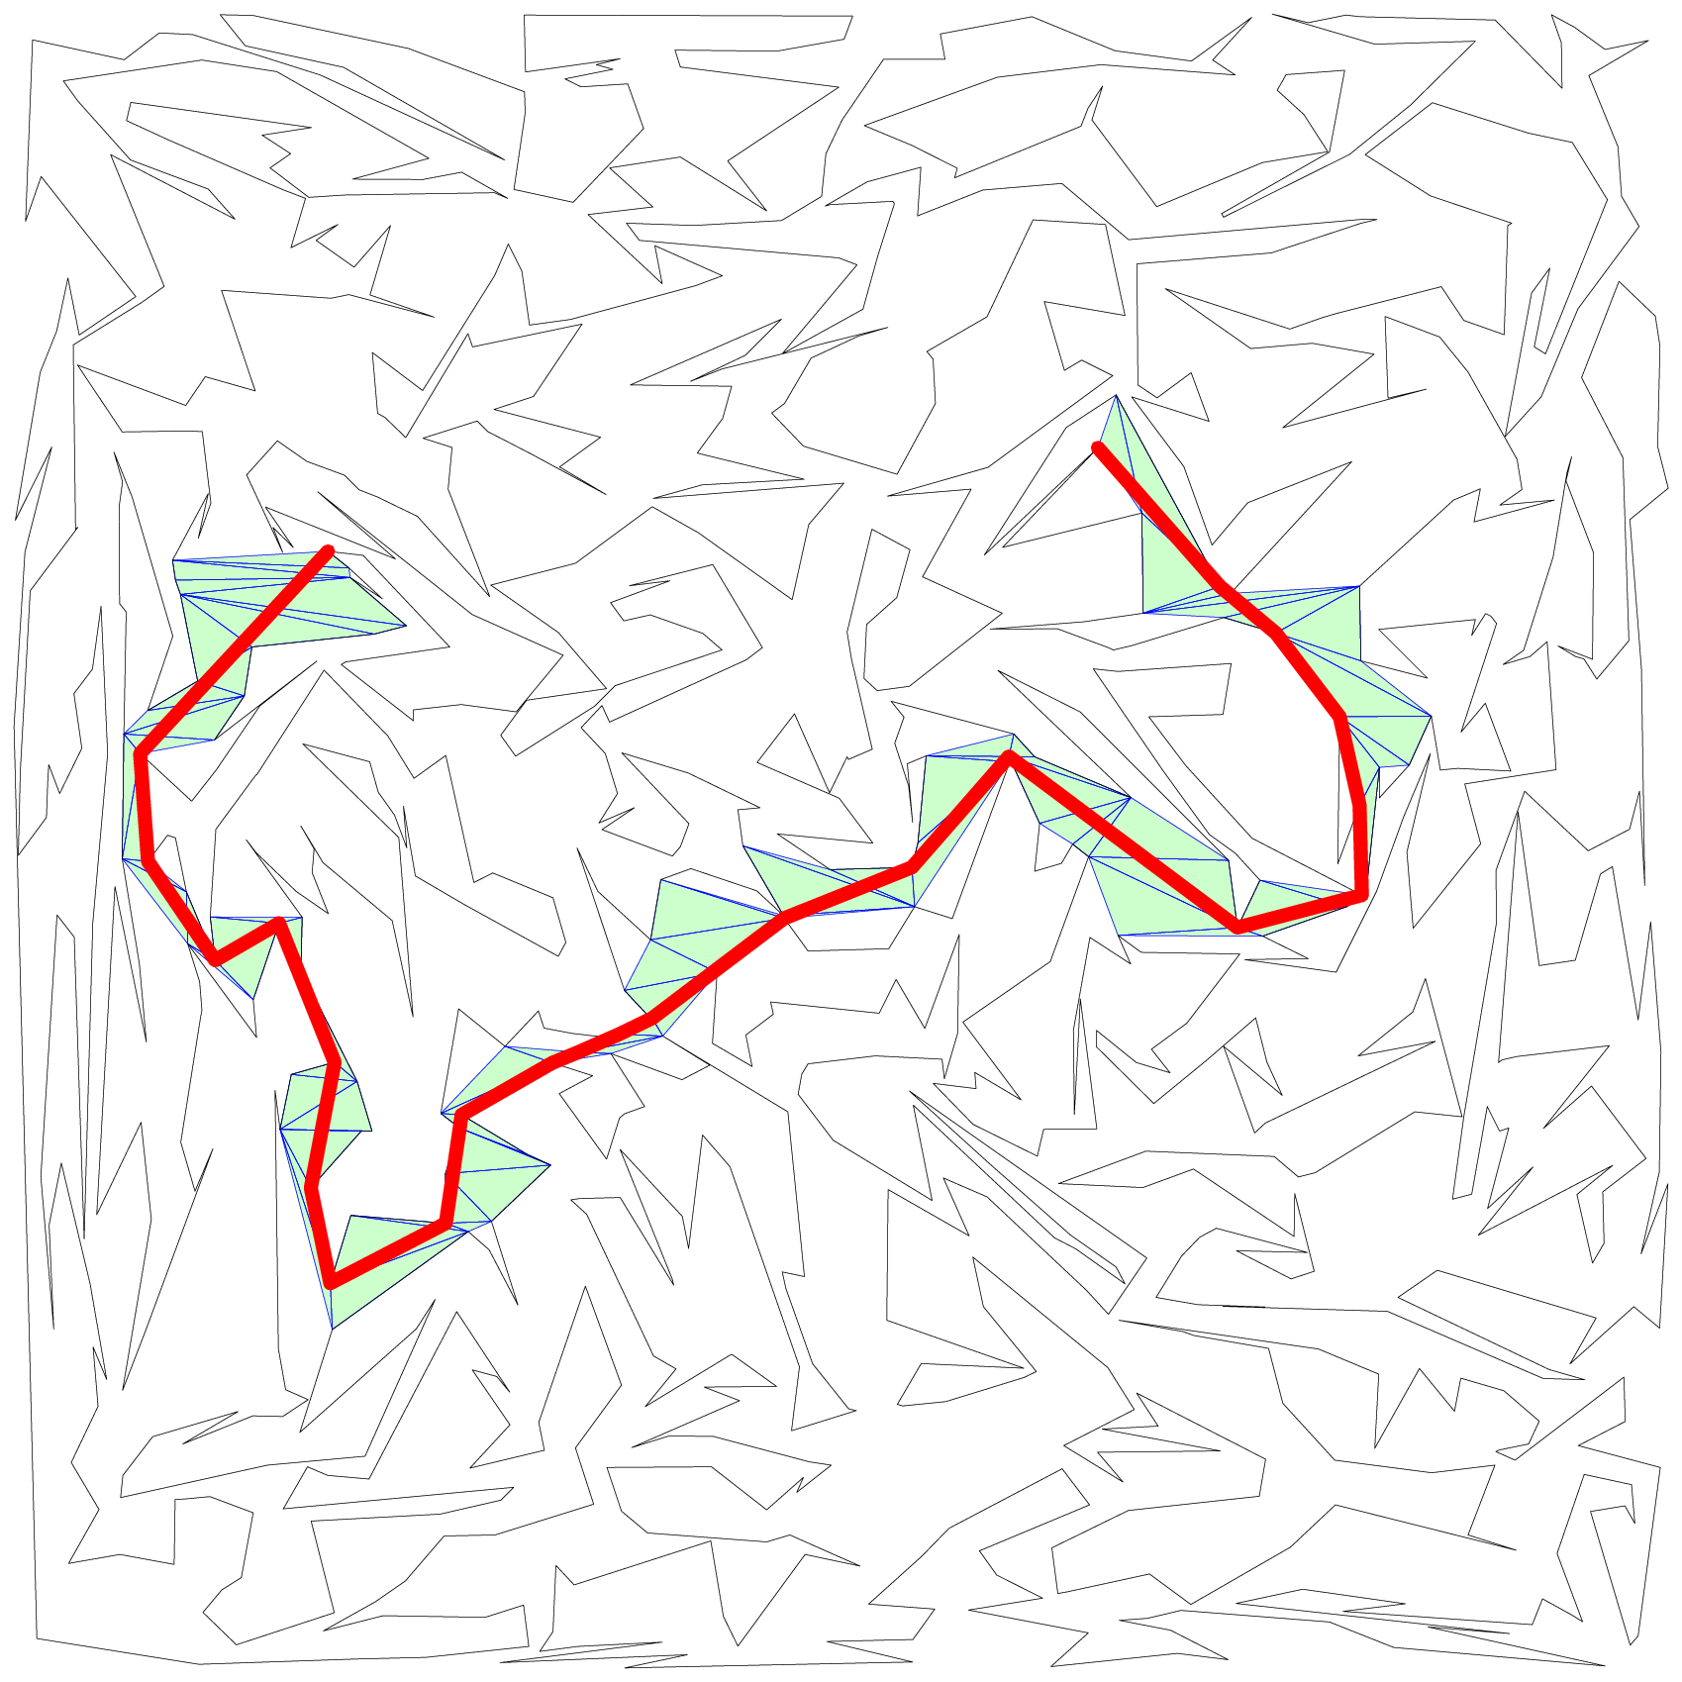
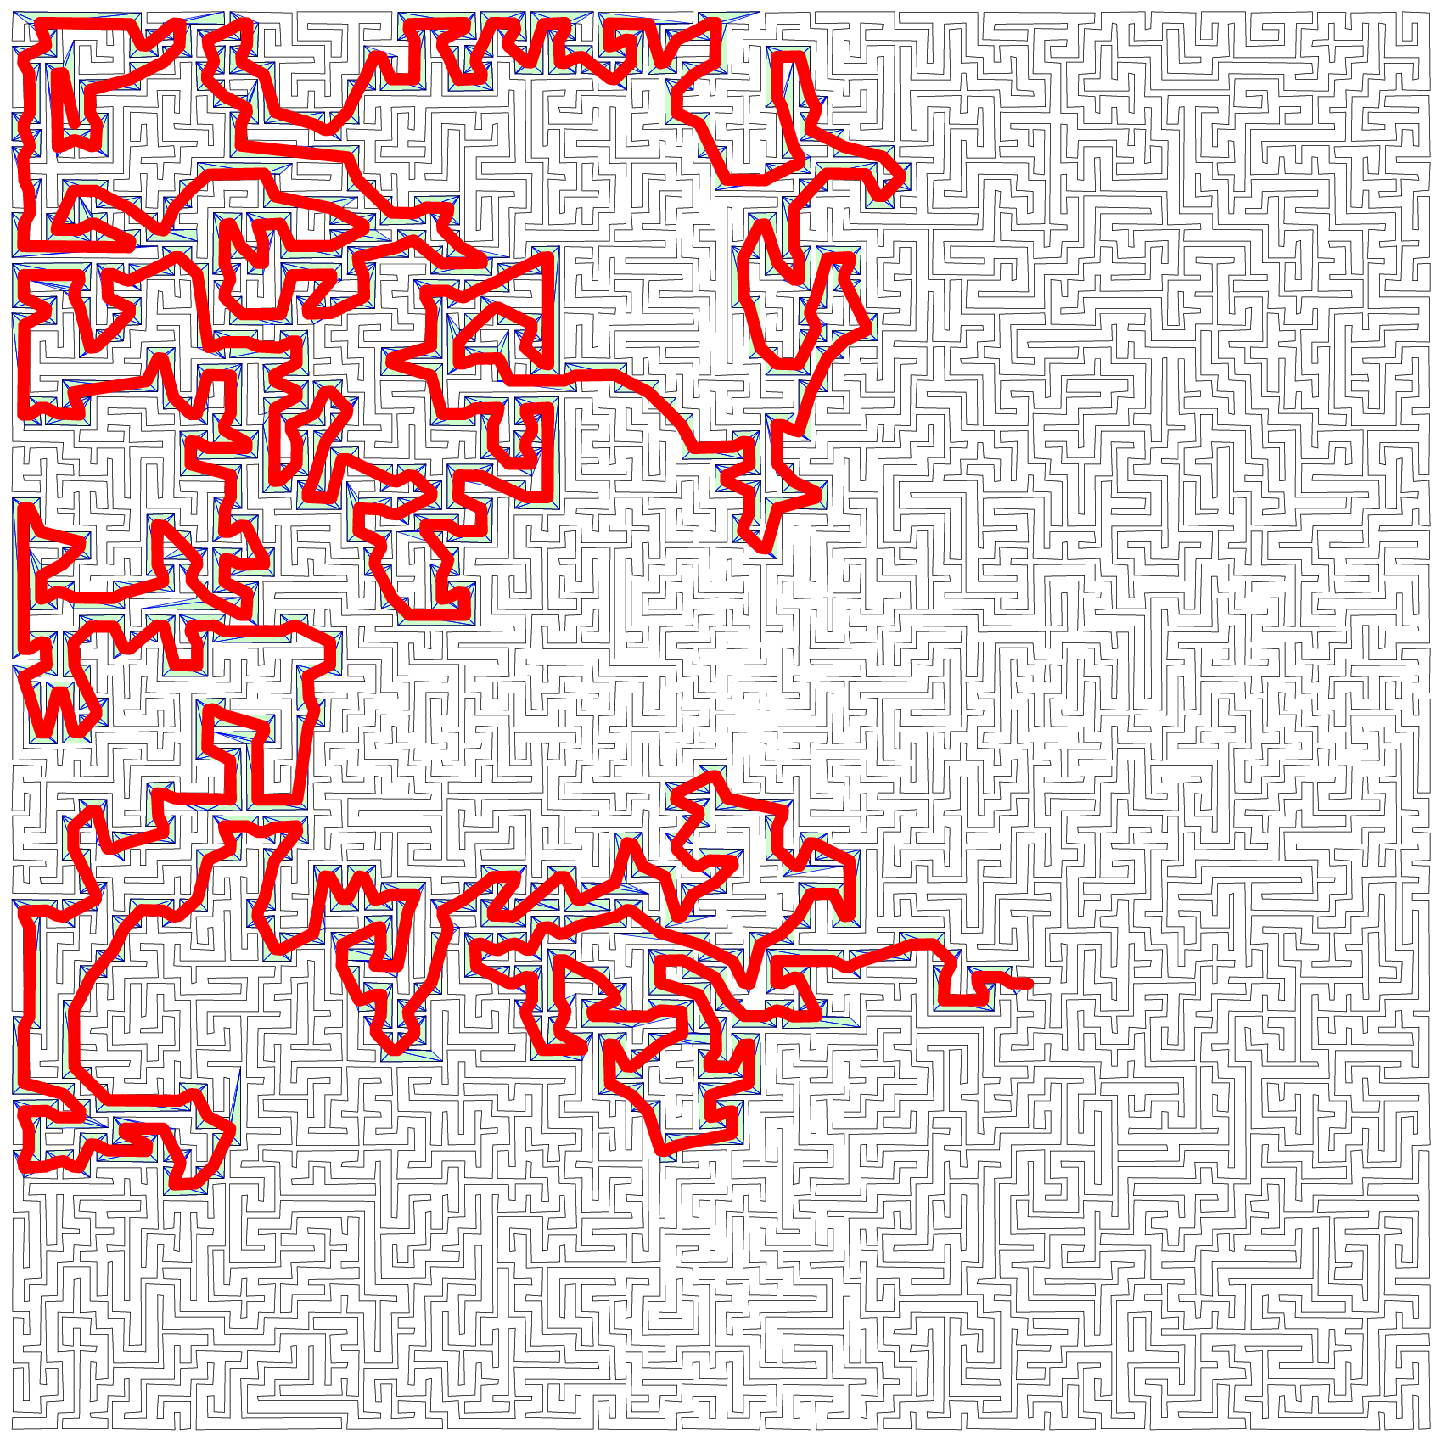
Problem D: Dire Strait
Find the shortest path between two vertices in a simple polygon,
with up to 100,000 vertices, given a triangulation.
•
The dual graph of a triangulated polygon has N-2 vertices, and N-3 internal edges, which makes it a tree. There is a unique triangle-strip path between endpoints which form a “sleeve”.
Time Complexity: O(N)

Slide 6
Problem D: Dire Strait
•
The “Funnel Algorithm” (Lee-Preparata) finds the shortest path through a triangle strip. Maintain a visibility funnel consisting of the first triangle, and narrow it through successive “portals” defined by interior walls.
•
Once the funnel collapses into a straight line, we have to go around a corner. The corner is defined by which “side” of the last valid funnel we’d have to cross to visit the next portal. Advance to it and repeat.
Time Complexity: O(N)

Slide 7
Problem E: Elderberry Wine
Make wine requiring berries, sugar, and water in a 12:12:40 ratio, topping up supplies until all initial stock is exhausted.
•
Because every gram of initial stock is consumed, total amounts are determined by the ingredient in greatest excess.
•
Compute required recipe units directly: M = max(berries / 12, sugar / 12, water / 40).
•
Ordered quantities are the remaining deficits: max(0, 12M − berries), max(0, 12M − sugar), and max(0, 40M − water).
Note: Large numbers need high precision (long double) or carefully avoiding division until the end.
Time Complexity: O(1)

Slide 8
Problem F: Footnotes
Extract two bracketed substrings as footnotes so that the main text and each footnote contain exactly one-third of all letters.
•
Let L be total letters. If L is not divisible by 3, output impossible immediately.
•
Parse matched brackets into a syntax tree and compute letter counts for each bracketed subtree in linear time O(|s|).
•
Check two valid configurations: two disjoint subtrees each of size L/3, or a nested subtree of size L/3 inside one of size 2L/3.
Time Complexity: O(|s|)

Slide 9
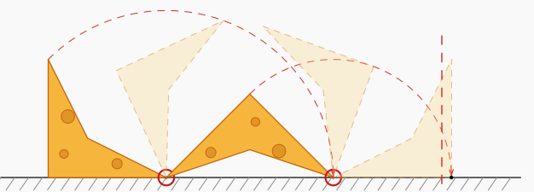
Problem G: Gloucester Somersault
Count the full 360-degree clockwise rotations for a rolling polygonal cheese to cross finish line x = m along ground y = 0.
•
Inner vertices never touch the ground; the rolling depends solely on the 2D convex hull of the vertices.
•
In one full 360-degree rotation, the cheese rolls forward by exactly the convex hull perimeter P.
•
Identify initial rightmost ground contact x₀ (where y = 0). The required rotations equals ceil((m − x₀) / P).
Note: Test data in the contest did not check the “strict” case. Online judge data will have more cases.
Time Complexity: O(N log N)

Slide 10
Problem H: Hoptimisation
Order up to 16 distinct cell names along a 1D hopscotch line to minimize the total travel distance across N consecutive hops.
•
This is the NP-hard Minimum Linear Arrangement problem. Since k ≤ 16 allows us to use an exponential-time algorithm, we can still solve it exactly.
•
Rewrite total hopping distance as the sum of “cutting across” all cell boundaries between all hops.
•
Evaluate DP over 2¹⁶ subsets:
dp[mask] = min(dp[mask \ {v}]) + cut_cost[mask]
The cut_cost counts edges crossing the boundary between “mask” and “~mask”.
Time Complexity: O(N + 2^k · k)

Slide 11
Problem I: Inverse Sum
Find distinct positive integers a and b that minimize a + b subject to 1/n = 1/a + 1/b.
•
Rearrange 1/n = 1/a + 1/b to ab − na − nb = 0, which factors cleanly into (a − n)(b − n) = n².
•
Set x = a − n and y = b − n so that x · y = n². The sum to minimize is a + b = 2n + x + y with x ≠ y.
•
The sum x + y is minimized when divisors are closest. Factor n in O(√n) and use the factorisation to pick the largest divisor x < n of n².
Time Complexity: O(√n + d(n²)) // where “d(n)” is the number of divisors of n

Slide 12
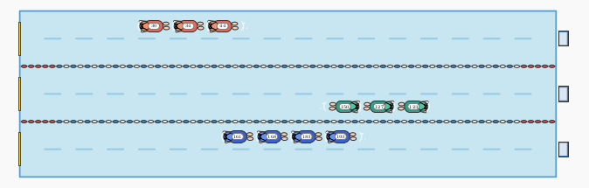
Problem J: Jammer Jam
Assign N swimmers to L lanes where each lane swims at its slowest member's pace, maximizing overall average speed.
•
Sort swimmers by speed. Optimal lanes form contiguous intervals [i, j], each costing (j − i + 1) · speed[i]. Dynamic programming with O(N · L) states and O(N) transitions per state works, but is too slow.
•
Because the interval cost function is convex and fits the quadrangle inequality there are multiple optimisation opportunities. Both Convex Optimisation and Divide-And-Conquer shave a factor of N.
•
You may go even further and use Lagrange relaxation (AKA “Aliens Method”) to nearly eliminate L too.
Time Complexity: O(N log N) or O(N log(range))

Slide 13
Problem L: Lawn Stripes
Direct a lawn roller across an n × n garden so each square metre finishes flattened in its designated cardinal direction in under 10n² moves.
•
Each cell has out-degree 1 pointing in its required exit direction, making the lawn a directed functional graph.
•
Following arrows from the starting position leads to a reachable cycle or boundary sink.
•
Reverse graph edges to form trees rooted at the sink; perform DFS to construct an Euler tour covering all cells within 10n² moves.
Time Complexity: O(N²)

Slide 14
Problem K: Kilt Quilt
Reconstruct a minimum sequence of full horizontal and vertical brush strokes to paint an n × m tartan canvas.
•
Every cell must be covered: either all rows or all columns must be painted. Assume without loss of generality all rows are painted.
•
Any unpainted "clean" column reveals the authentic required color of every single row stroke.
•
Non-matching cells establish strict stroke precedence (row before column or column before row); verify acyclicity via topological sort.
Time Complexity: O(N³)

Slide 15
Problem M: Mid Clocking
Allocate N tasks to S slots in a row to minimize makespan, where processors run at 100% (0 neighbors), 60% (1 neighbor), or 30% (2 neighbors).
•
Binary search the optimal makespan T with a precision tolerance of 10⁻⁶.
•
For a candidate time T, classify tasks: duration / 0.6 > T requires 0 neighbors; duration / 0.3 > T requires at most 1 neighbor.
•
Check feasibility against the optimal periodic layout pattern: isolated singletons, adjacent pairs, and dense 30% blocks.
Time Complexity: O(N log N + log(range / ε) · log N)

